Slide 1
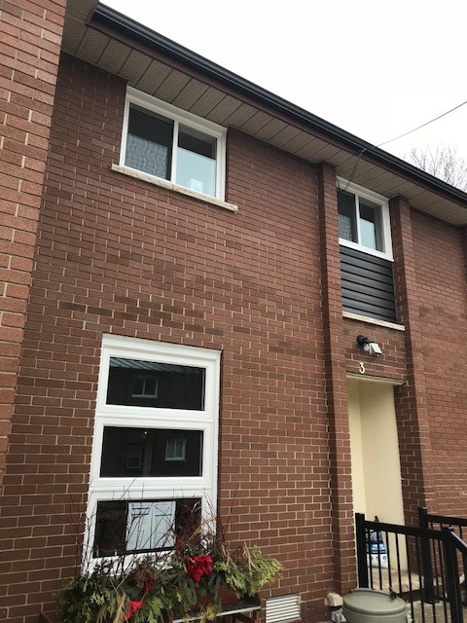
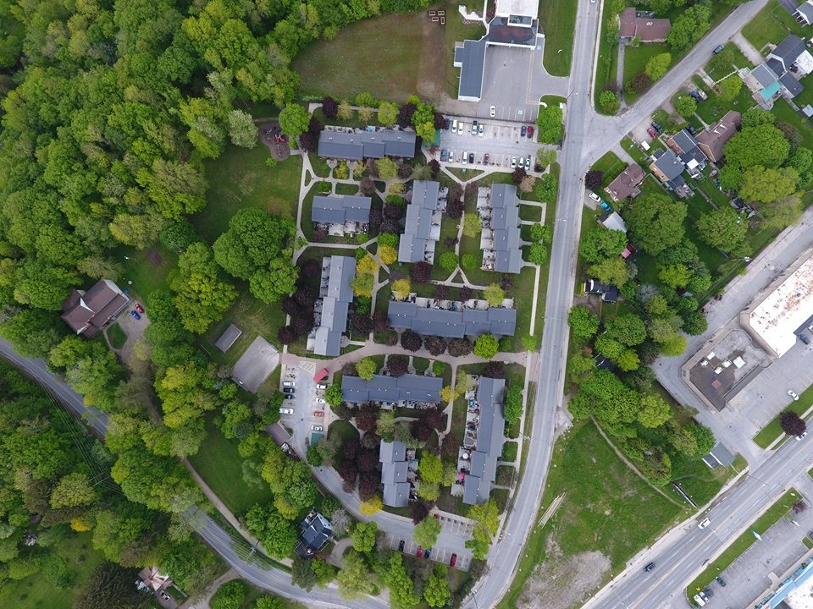
HOME TAKEOVER
A Guide for Organizations and Service Providers
Notes:
Welcome and Introductions
Please feel free to adapt this presentation to fit the learning needs of your organizational staff.

Slide 2
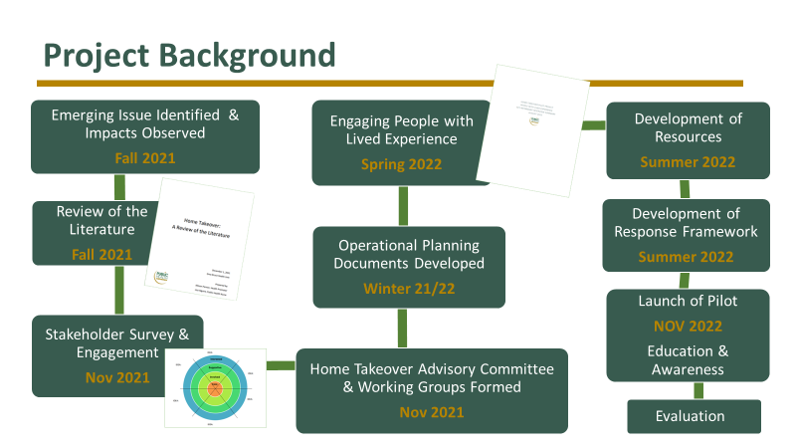
Notes:
*Aligns with ‘Here’s the Current Situation’ p. 6
Background and timeline on the Home Takeover Pilot Project:
1. Grey County Housing identified the emerging issue. Impacts for tenants, families, individuals taking over the unit(s) and the neighbourhood were being observed.
2. Literature search was conducted and a summary report presented at stakeholder meeting.
3. Stakeholder survey conducted with 22 partners to better understand existing response and gaps in responding to home takeovers.
4. Stakeholder Engagement Wheel was used to identify stakeholder interest and level of participation in identified areas of action/deliverables.
5. Advisory Committee formed to address the issue collaboratively.
6. Interviews were conducted with people with lived experience to better understand the realities of a home takeover situation.
7. Resources adapted and created (posters, checklist, guidebook, response framework, etc.).
8. Launch of the project (Media Release to the public). Awareness and education through media platforms.
9. Evaluation of the project using outcomes identified in evaluation framework.

Slide 3

This presentation is intended to accompany the Home Takeover Guidebook (2022)
The guidebook was designed to assist organizations and service providers in offering opportunities for education and awareness concerning home takeovers for vulnerable tenants, frontline workers and the broader community.

Slide 4
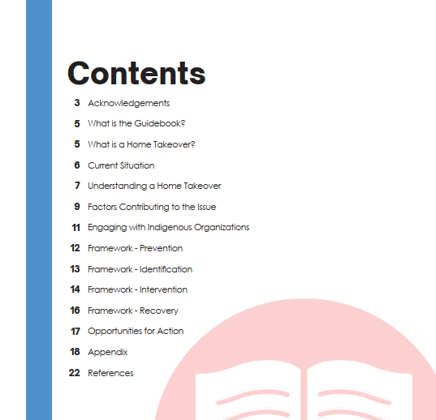
Notes:
Guidebook Table of Contents

Slide 5
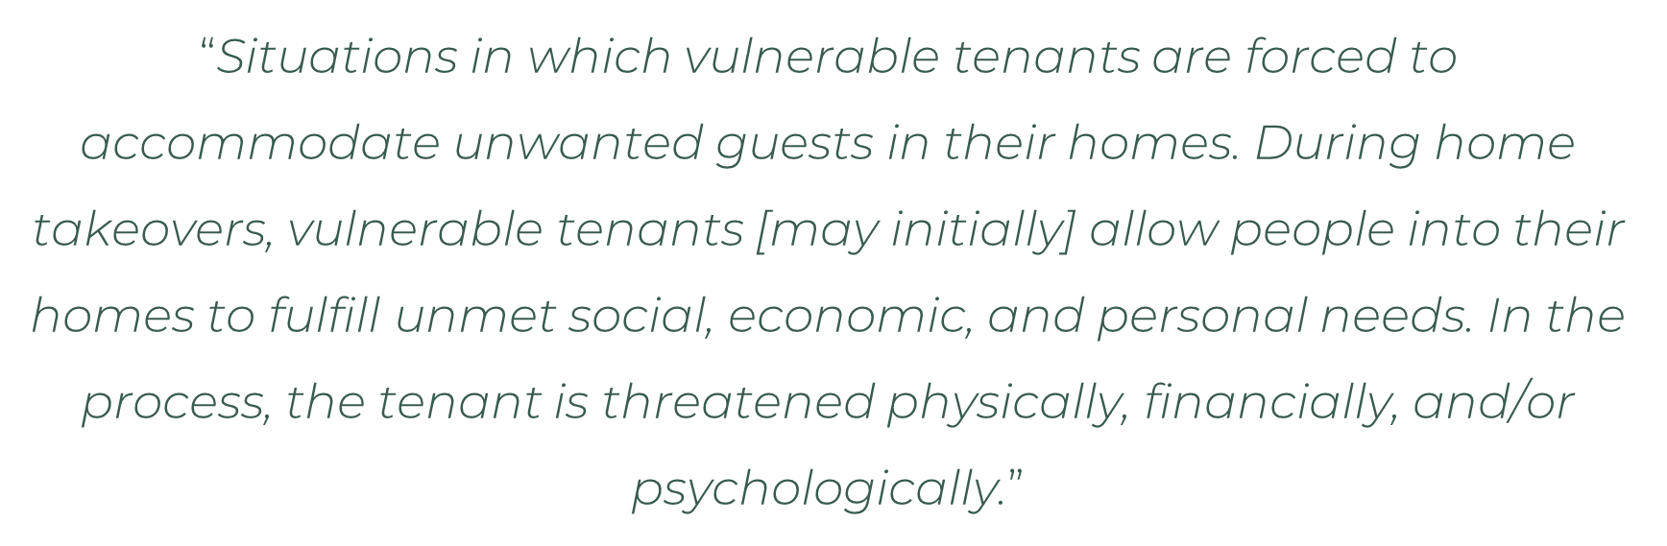
What is a Home Takeover?
The Dream Team,
“Safe at Home” Research Project

Slide 6

“Perpetrator”
“Target”
  “Business Predator”
  “Vulnerable Perpetrator”
  Unmet social, economic, and/or personal needs
  Common Characteristics:
    Lonely
    Isolated
    Marginalized
Notes:
*Aligns with p. 7 in Guidebook

Slide 7

Four Broad Forms of a Home Takeover
Substance-use related takeovers
Takeovers related to homelessness
Takeovers involving older adults
Takeovers of people with vulnerabilities
Notes:
*Aligns with p. 5 in Guidebook

Slide 8

Harms & Impacts
Direct Consequences:
  Eviction / Loss of housing
  Criminal charges
  Financial cost
  Safety issues
  Theft
  Loss of control over own home
  Abuse
Personal Consequences:
Mental & physical health consequences
Loss of dignity
Decreased self-esteem
Loss of self-control and power
Other Possible Consequences:
Sexual exploitation
Forced labour
Children may feel scared/confused
Notes:
*Aligns with p.8 in Guidebook

Slide 9
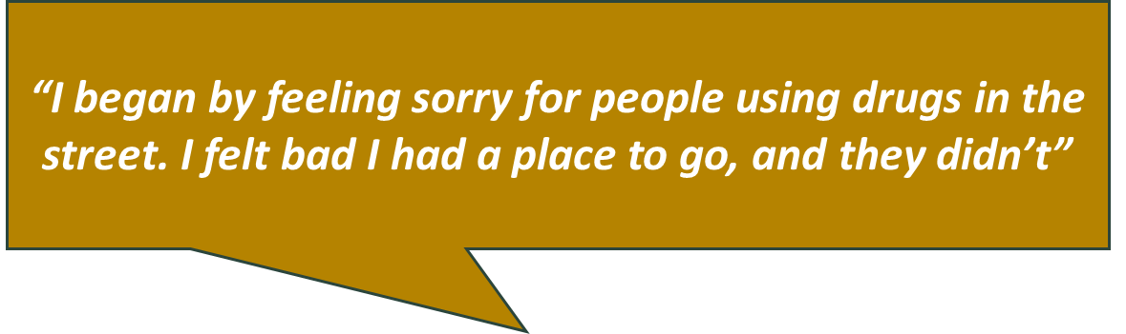
Key Factors Contributing to a Home Takeover
Housing crisis
Substance use
Lack of long-term treatment for substance use
Lack of safe places to use substances
Mental health concerns
Isolation, loneliness and marginalization
Interview Participants had:
Empathy for perpetrator
Pressure to house perpetrator
Desire for social connectedness
Hope for financial/household contributions
Notes:
*Aligns with p. 9 in Guidebook
Results from key informant interviews identified that a lack of temporary housing, addiction and MH issues were some of the key factors contributing to HTs in our community.
Factors that contribute to a home takeover include:
- housing crisis (long wait lists for affordable housing and inadequate access to liveable spaces, emergency shelters and transitional housing)
- substance use (seeing increased opioid-related ER visits in Grey Bruce)
- and individuals experiencing isolation, loneliness and marginalization
Other factors identified as contributing to the targets vulnerability to a HT include: empathy for the perpetrators situation and a desire to help, significant pressure to house the perpetrator, a desire for social connectedness, and hope for financial/household contributions like splitting rent, groceries, household tasks, drugs, etc.
key factors may look different for different communities & cultures.

Slide 10
Engaging with Indigenous Organizations
The term “Home Takeover” may be associated with negative feelings and should be used with careful consideration
Beliefs, traditions and the concept of “home” may differ
Elders often provide shelter/care to family members
Overcrowding may happen, and can break down family dynamics
Principles of Reconciliation
Looking to learn about Indigenous Homelessness, and the 12 dimensions?
Visit COHIndigenousHomelessnessDefinition.pdf (homelesshub.ca)
Notes:
*Aligns with p. 11 in Guidebook

Slide 11
Prevention
Tenant and worker relationship
Tenants are connected to supports and services
Service providers avoid placing clients with friends or family who are vulnerable and/or have a damaging history with the client
Tenants are aware of the risks
Agreement that service providers can communicate and share information about the tenant
Isolation is reduced by ensuring individual feels a part of a larger community, encourage tenant to participate in a community with which they identify
Notes:
Aligns with p. 16 in Guidebook

Slide 12

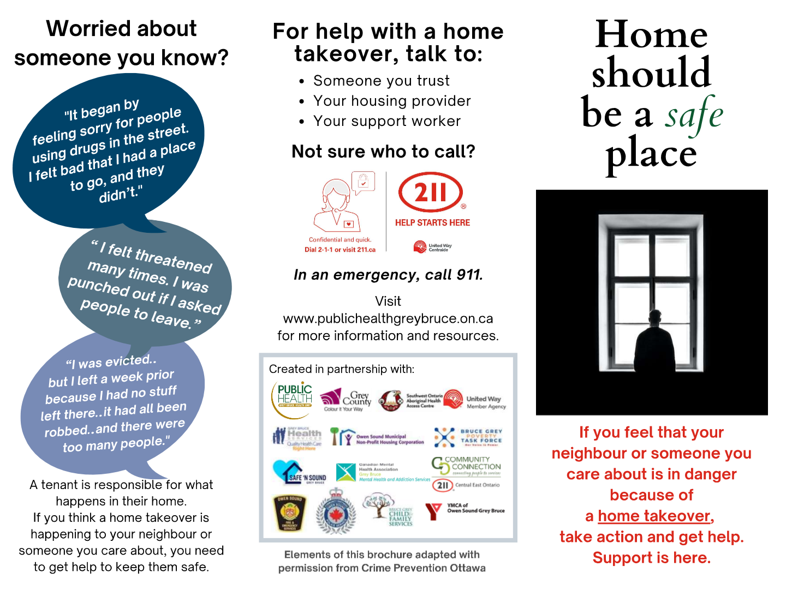
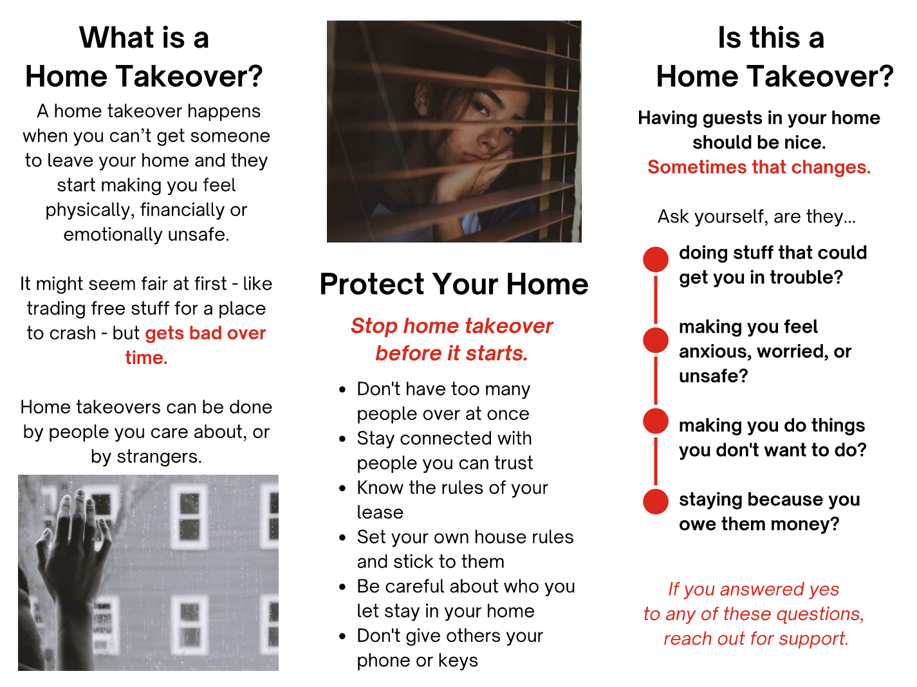
Prevention Resources
Notes:
Home Should be Your Safe Place (Postcard)
Home Should be a Safe Place (Tri-fold brochure)
For all current resource materials - Home Takeover (publichealthgreybruce.on.ca)

Slide 13
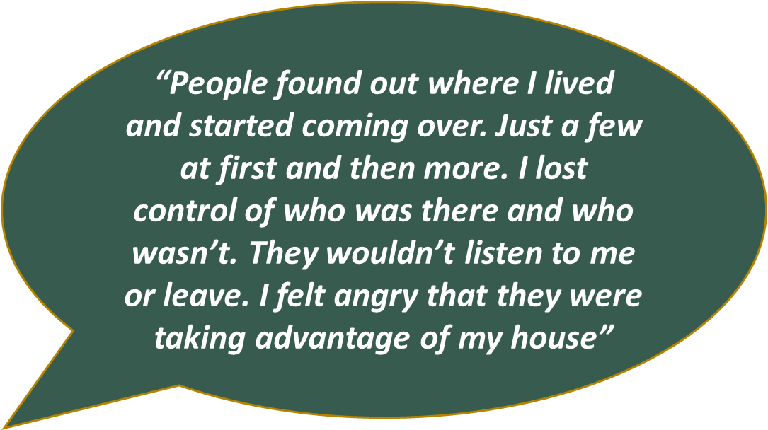
Identifying a Home Takeover
Direct disclosure
Reluctant to allow worker into unit, noticeably absent from unit
Tenant has not checked in with worker in some time
Increase in complaints (noise, visitors, vehicles/bikes outside)
Change in tenant’s financial situation
Increase in reports that individual is more isolated
Content in unit suggests more individuals are staying there than those that reside there
Notes:
Aligns with p. 17 in Guidebook

Slide 14



Identification Resources
Notes:
10 Question Checklist
Posters

Slide 15
Intervention
Interventions depend on circumstances
Encourage tenants to talk to someone they trust
Make the environment uncomfortable for the individual(s) taking over the home
Motivate the tenant to resolve the takeover by highlighting how something they care about is being affected
Develop plans and boundaries
Use common language
Use “circle of care” approach
Educate tenant on their rights, responsibilities and consequences
Notes:
Aligns with p. 18-19 (Refer to detailed list of strategies in Guidebook)

Slide 16
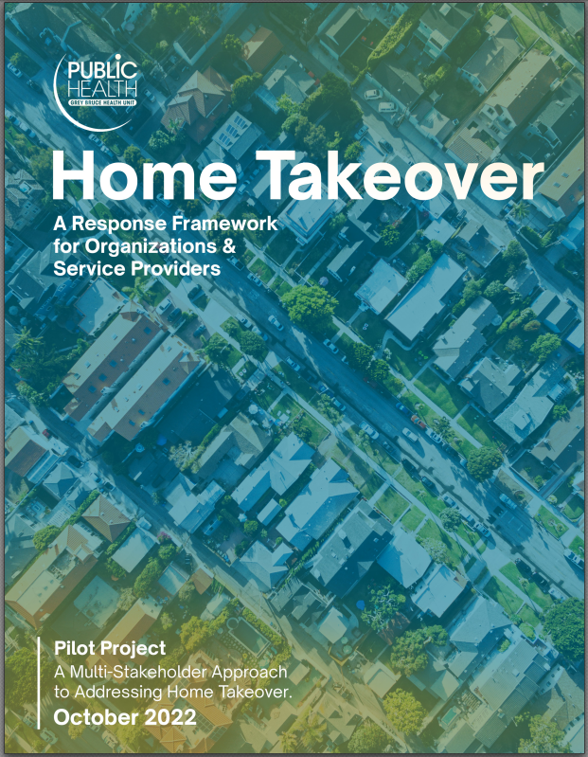
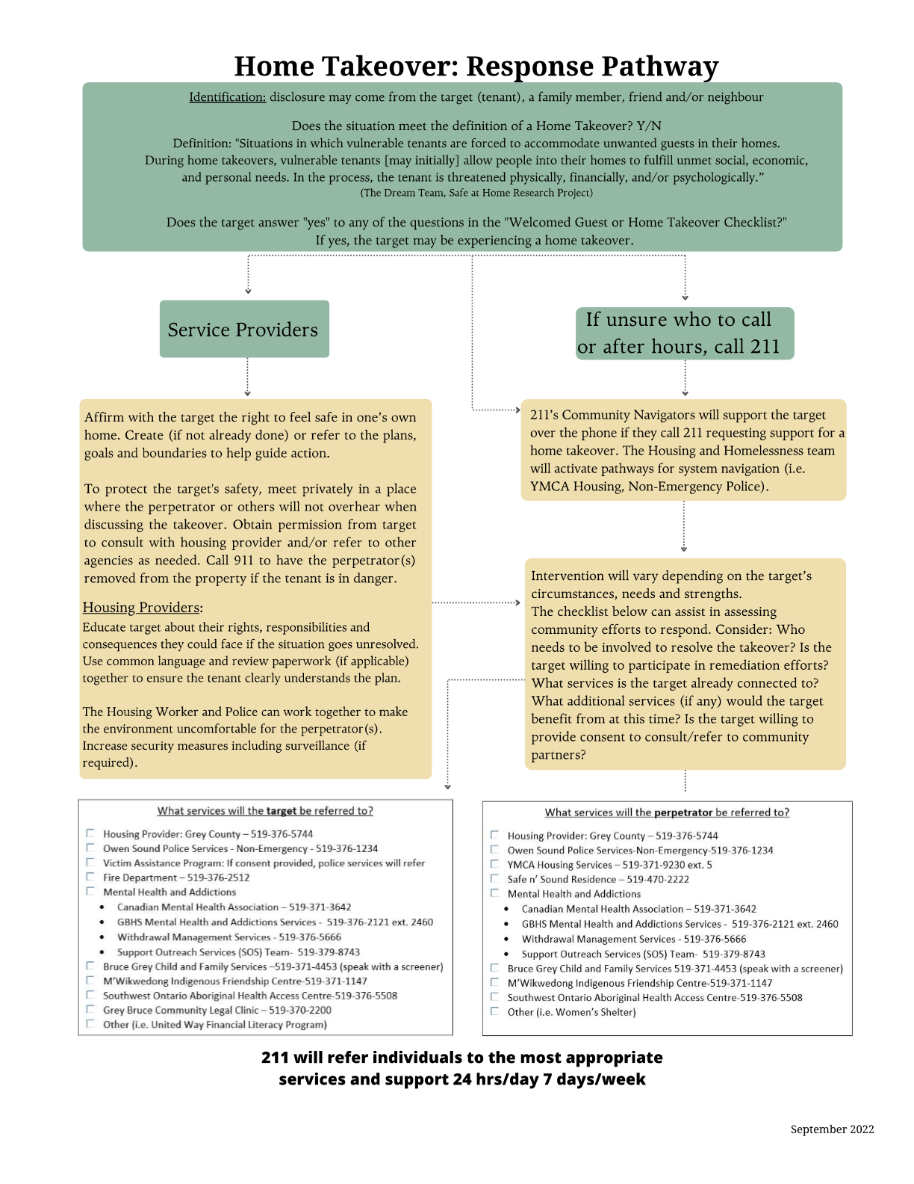
Response Framework
Notes:
Home Takeover Response Framework
Home Takeover Response Pathway

Slide 17
Recovery
“It was helpful when [housing worker] acknowledged the problem and gave it a name”
Frequent check-ins and well-being visits
Work with client to develop recovery plan
Recovery may be centred on making the home liveable again
Consider reaching out to the perpetrator (if possible)
Ensure people removed from home takeover are housed
Go through preventative methods to avoid future takeovers
Consider seeking out other housing options if target’s safety continues to be threatened
Notes:
Aligns with p. 20 in the Guidebook: Measures to support an individual following a takeover.

Slide 18
Opportunities for Action
For Organizations:
Provide education & training for staff on Home Takeovers
Adopt and execute Home Takeover Response Framework
Encourage system changes to collect better local data
Develop home takeover policy/guideline
Update lease agreements
Collaborate with local partners and organizations
Notes:
*Aligns with p.17 in Guidebook

Slide 19

Opportunities for Action
For Service Providers:
Participate in education & training
Review and follow Home Takeover Response Framework
Know your role in preventing, identifying, responding to and supporting recovery
Obtain consent from tenant to support enhanced communication and information sharing with other service providers

Slide 20
Where to find more information:
All home takeover project materials can be found at:
Home Takeover (publichealthgreybruce.on.ca)

Slide 21
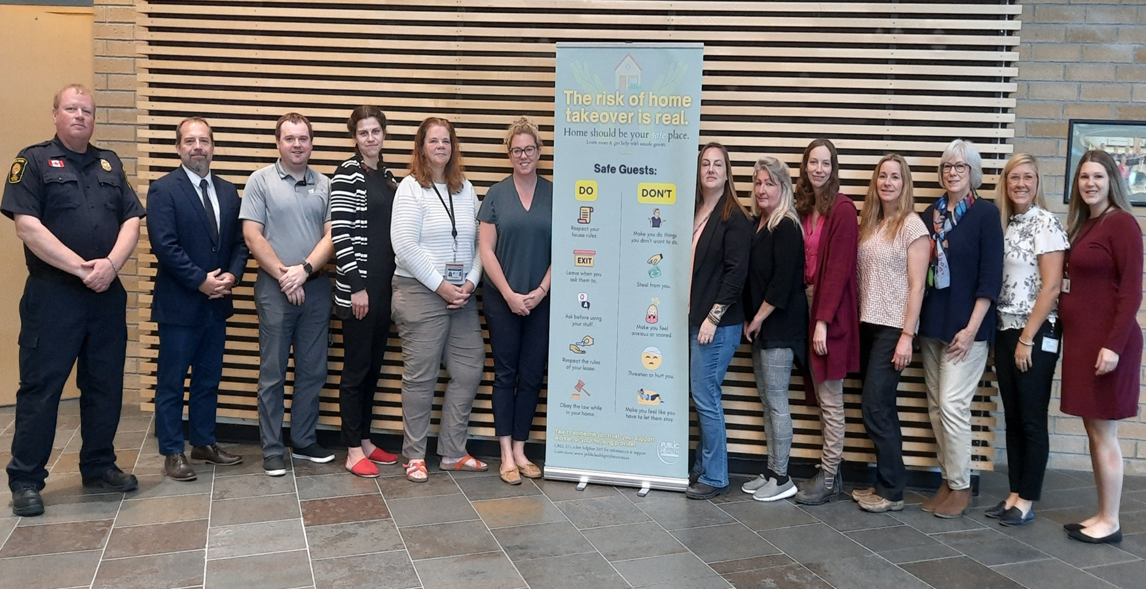
Acknowledgements
Content in this presentation, and accompanying Guidebook, was adapted with permission from Crime Prevention Ottawa.
Special thanks to all of the participating community partners!
Home Takeover Pilot Project Advisory Committee, 2022

