Slide 1
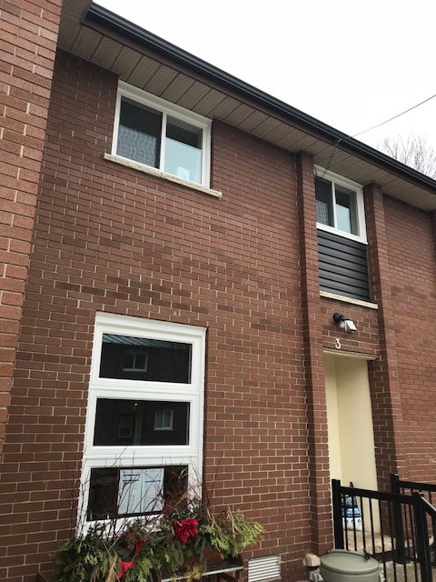
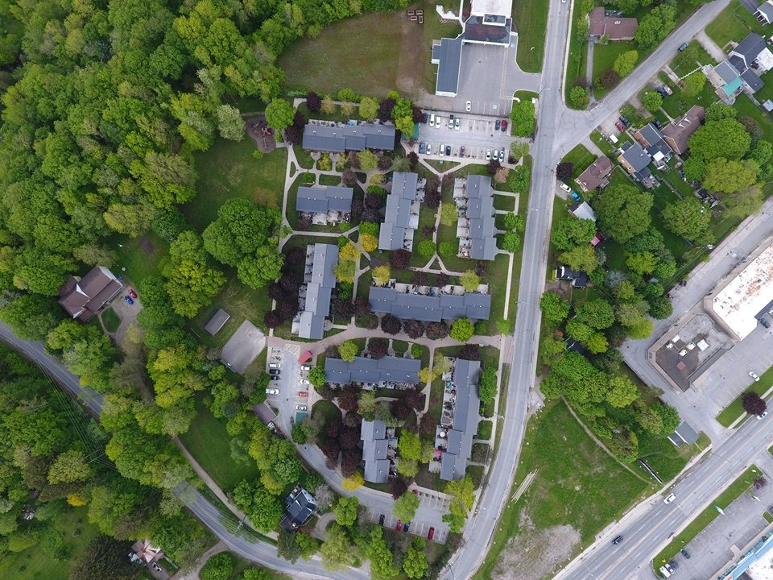
HOME TAKEOVER
A Guide for Organizations and Service Providers
Notes:
Welcome and Introductions
Please feel free to adapt this presentation to fit the learning needs of your organizational staff.

Slide 2

Notes:
*Aligns with ‘Here’s the Current Situation’ p. 6
Background and timeline on the Home Takeover Pilot Project:
1. Grey County Housing identified the emerging issue. Impacts for tenants, families, individuals taking over the unit(s) and the neighbourhood were being observed.
2. Literature search was conducted and a summary report presented at stakeholder meeting.
3. Stakeholder survey conducted with 22 partners to better understand existing response and gaps in responding to home takeovers.
4. Stakeholder Engagement Wheel was used to identify stakeholder interest and level of participation in identified areas of action/deliverables.
5. Advisory Committee formed to address the issue collaboratively.
6. Interviews were conducted with people with lived experience to better understand the realities and intricacies of a home takeover situation.
7. Resources adapted and created (posters, checklist, guidebook, response framework, etc.).
8. Launch of the project (Media Release to the public). Awareness and education through media platforms.
9. Evaluation of the project using outcomes identified in evaluation framework.

Slide 3

This presentation is intended to accompany the Home Takeover Guidebook (2022)
The guidebook was designed to assist organizations and service providers in offering opportunities for education and awareness concerning home takeovers for vulnerable tenants, frontline workers and the broader community.

Slide 4
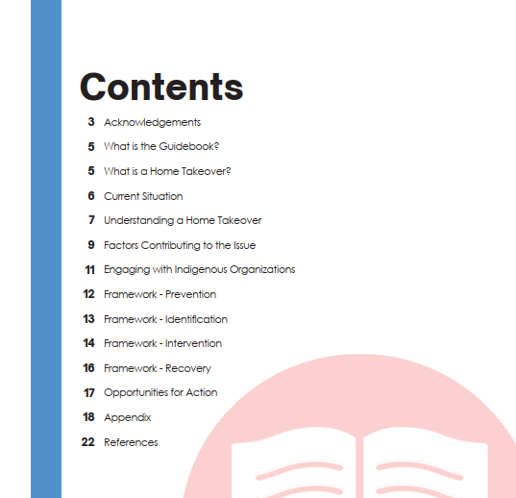
Notes:
Guidebook Table of Contents

Slide 5
What is a Home Takeover?
“Situations in which vulnerable tenants are forced to accommodate unwanted guests in their homes. During home takeovers, vulnerable tenants [may initially] allow people into their homes to fulfill unmet social, economic, and personal needs. In the process, the tenant is threatened physically, financially, and/or psychologically.”
The Dream Team,
“Safe at Home” Research Project

Slide 6
Who is Involved?
The Target | The Perpetrator
The rightful occupant of the home/unit Tend to have vulnerabilities Most likely targets: people who have drug dependency, disabilities, mental health issues, were recently/formerly homeless, immigrants, women, single mothers, low-income women with children, and elderly | The person (or people) taking over the home/unit May be vulnerable and engaging in home takeover to fulfill their own unmet social or economic needs
Notes:
*Aligns with p. 7 in Guidebook
Two parties: the person or people taking over the unit (perpetrator), and the rightful occupant of the unit/home (the target).
People who are targeted in a HT tend to have vulnerabilities. Many tenants are unaware that their personal vulnerabilities make them more susceptible to a HT, and they are unable to avoid or escape the perpetrator due to lack of supports and/or resources.
Perpetrators are most likely to target people who have drug dependency, disabilities, mental health issues, were recently/formerly homeless, immigrants, women, single mothers and low-income woman with children. Elderly people may also be targeted and this group is especially vulnerable to victimization through financial exploitation.

Slide 7

Four Broad Forms of a Home Takeover
Substance-use related takeovers
Takeovers related to homelessness
Takeovers involving older adults
Takeovers of people with vulnerabilities
Notes:
*Aligns with p. 5 in Guidebook
There are many variations within each broad category of takeover and these categories are not mutually exclusive. A homeless individual may take over a home because they need a place to stay, but also are involved in drug associated acquaintances.
Person who conducts the home takeover:
May be looking to make money through illegal activity, may involve illicit drugs or gangs
May initially offer money, a sense of belonging, or fulfill other unmet social/economic needs of the target
May exploit a substance dependency in order to enter the home by offering free drugs, only to later force the target into participating in the drug trade.
May use guilt or manipulation to stay in the home
The takeover of an older adult may be a family member, or someone that has been invited into the home to relieve isolation and loneliness or to help with rent or other expenses
HT may begin under the pretense of mutual benefits, but become outweighed by harms over time.
Home Takeover Videos available (Ottawa Crime Prevention) - Home Takeovers – YouTube

Slide 8

Harms & Impacts
Notes:
(engage audience) – What do you think are some of the harms and impacts of a Home Takeover?

Slide 9
Harms & Impacts
Direct Consequences:
  Eviction / Loss of housing
  Criminal charges
  Financial cost
  Safety issues
  Theft
  Loss of control over own home
  Abuse
Personal Consequences:
Mental & physical health consequences
Loss of dignity
Decreased self-esteem
Loss of self-control and power
Other Possible Consequences:
Sexual exploitation
Forced labour
Children may feel scared/confused
Notes:
*Aligns with p.8 in Guidebook
Consequences of Home Takeovers are numerous.
Direct consequences: When a perpetrator engages in illegal activity within the unit, the rightful tenant is put at risk of eviction. Eviction can be devastating to a vulnerable tenant particularly if they lose their place in subsidized housing. Targets can experience threats, violence, coercion, abuse and exploitation
Personal Consequences: Targets may be exposed to threats, violence, coercion, abuse and exploitation, all of which are associated with serious mental and physical health impacts. Other personal consequences may include loss of their dignity, self-esteem, self-control and power.
Other Consequences: Can be incidences of sexual exploitation and forced labour with a HT, and children and youth are not excluded from these harms.
For children, the home and neighbourhood are crucial in HGD. They may be exploited to support the drug trade, made to commit thefts, store illegal goods.

Slide 10
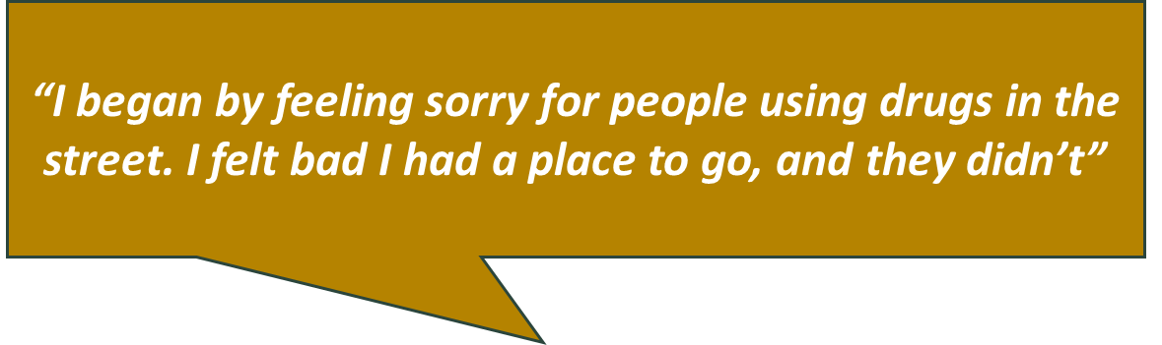
Key Factors Contributing to a Home Takeover
Housing crisis
Substance use
Lack of long-term treatment for substance use
Lack of safe places to use substances
Mental health concerns
Isolation, loneliness and marginalization
Interview Participants had:
Empathy for perpetrator
Pressure to house perpetrator
Desire for social connectedness
Hope for financial/household contributions
Notes:
*Aligns with p. 9 in Guidebook
Results from key informant interviews identified that a lack of temporary housing, addiction and MH issues were some of the key factors contributing to HTs in our community.
Factors that contribute to a home takeover include:
- housing crisis (long wait lists for affordable housing and inadequate access to liveable spaces, emergency shelters and transitional housing)
- substance use (seeing increased opioid-related ER visits in Grey Bruce)
- and individuals experiencing isolation, loneliness and marginalization
Other factors identified as contributing to the targets vulnerability to a HT include: empathy for the perpetrators situation and a desire to help, significant pressure to house the perpetrator, a desire for social connectedness, and hope for financial/household contributions like splitting rent, groceries, household tasks, drugs, etc.
key factors may look different for different communities & cultures.

Slide 11
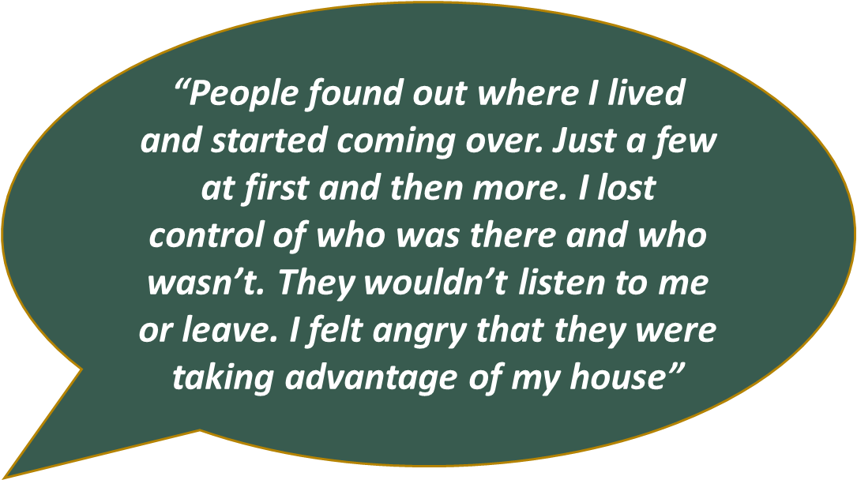

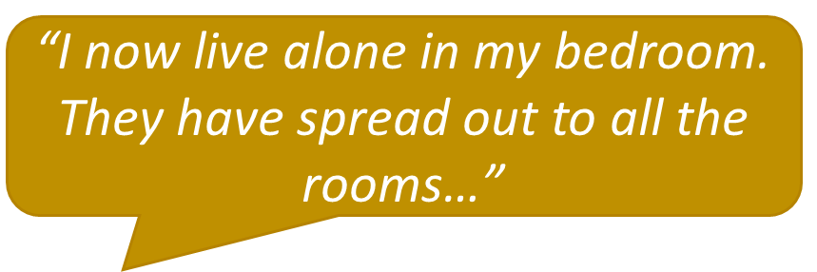
Notes:
Quotes from key informant interviews.

Slide 12
Engaging with Indigenous Organizations
The term “Home Takeover” may be associated with negative feelings and should be used with careful consideration
Beliefs, traditions and the concept of “home” may differ
Elders often provide shelter/care to family members
Overcrowding may happen, and can break down family dynamics
Principles of Reconciliation
Looking to learn about Indigenous Homelessness, and the 12 dimensions?
Visit COHIndigenousHomelessnessDefinition.pdf (homelesshub.ca)
Notes:
*Aligns with p. 11 in Guidebook
Throughout the project, we have and will continue to engage with Indigenous organizations. Conversations and shared stories have enhanced our understanding on the diversity of culture, language, needs and traditional practices among and within Indigenous communities.
The term “HT” may be associated with negative feelings (i.e. fear, conflict, loss, guilt, harm) and should be used with careful consideration when working with Indigenous peoples.
Beliefs, traditions and the concept of “home” may differ between Indigenous and non-Indigenous people. In Indigenous culture, “home” is viewed deeply as a web of relationships and responsibilities. Elders commonly shelter grandchildren and adult children to protect them from homelessness. This care is seen as natural and traditional hospitality. However, Elders are also subject to the harms from housing takeovers when assuming the care role and often sacrifice their own needed care.
Overcrowding can lead to crisis situations that may result in the breakdown of family dynamics or escalate family violence. Canada has issued calls to action on the unacceptable and overcrowded state of many Indigenous homes.
As part of the framework, the committee adopted locally developed principles in the Standing Strong Together to guide us in our communities, practices, and building relationships in a meaningful way, especially as the work evolves in other areas of GB. We are learning and will continue to learn.

Slide 13
Prevention
Tenant and worker relationship
Tenants are connected to supports and services
Service providers avoid placing clients with friends or family who are vulnerable and/or have a damaging history with the client
Tenants are aware of the risks
Agreement that service providers can communicate and share information about the tenant
Isolation is reduced by ensuring individual feels a part of a larger community, encourage tenant to participate in a community with which they identify
Notes:
Aligns with p. 16 in Guidebook
Trusting relationship between tenant and worker
Tenants are connected to supports and services that are beneficial to them
Service providers avoid placing clients with friends or family who are vulnerable and/or have a damaging history with the client
Tenants are aware of the risks of a home takeover
Agreement that service providers can communicate and share information about the tenant
Isolation is reduced by ensuring individual feels a part of a larger community, encourage tenant to participate in a community with which they identify

Slide 14

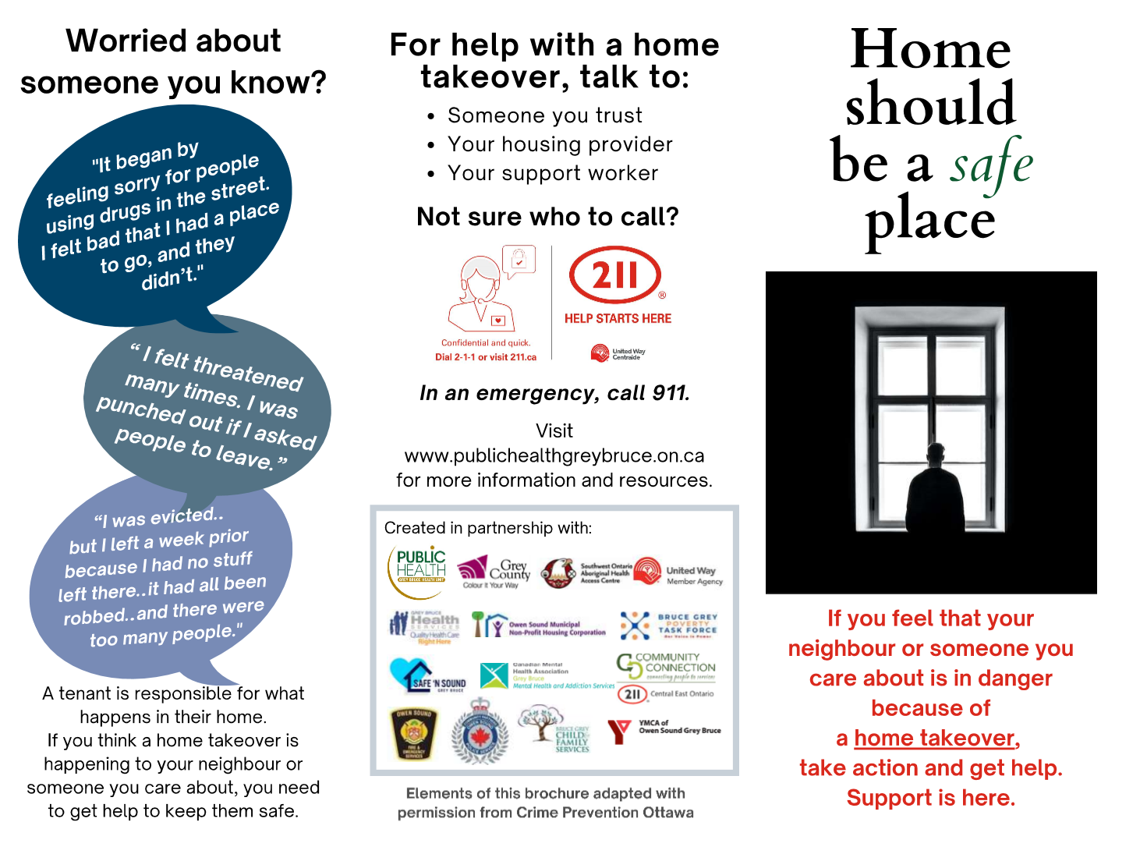
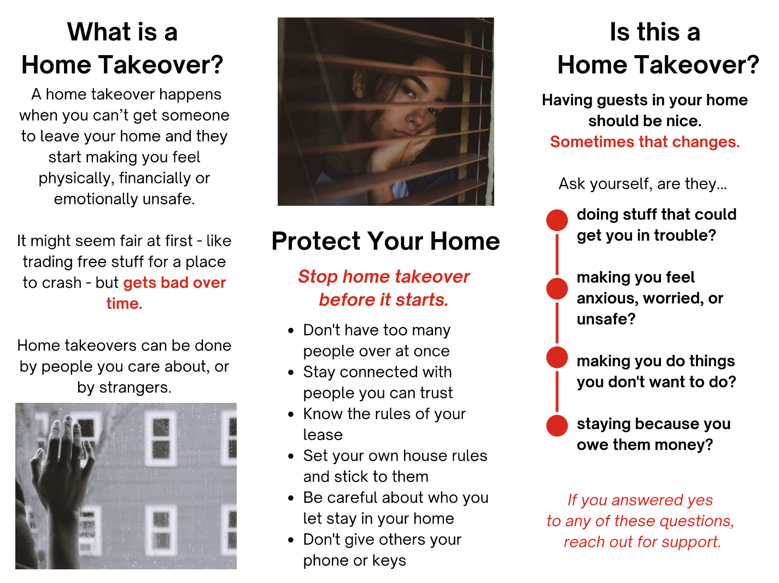
Prevention Resources
Notes:
Home Should be Your Safe Place (Postcard)
Home Should be a Safe Place (Tri-fold brochure)
For all current resource materials - Home Takeover (publichealthgreybruce.on.ca)

Slide 15

Identifying a Home Takeover
Direct disclosure
Reluctant to allow worker into unit, noticeably absent from unit
Tenant has not checked in with worker in some time
Increase in complaints (noise, visitors, vehicles/bikes outside)
Change in tenant’s financial situation
Increase in reports that individual is more isolated
Content in unit suggests more individuals are staying there than those that reside there
Notes:
Aligns with p. 17 in Guidebook
The most obvious way to identify a home takeover is through tenant disclosure, however often victims choose not to report the takeover for fear of repercussions.
The tenants neighbour, family or friends may also disclose that there is a home takeover happening, these reports are crucial – however sometimes these bystanders may be apprehensive to report for fear of identification by the perpetrator or because they believe nothing will be done in response.
Other ways a home takeover may be identified:
Tenant may be reluctant to allow worker into unit
Tenant has not checked in with worker in some time, is noticeably absent from the unit
Increase in complaints about a unit (noise, visitors, vehicles/bikes outside)
Noticeable change in tenants financial situation
Increase in reports that individual is more isolated from friends, family and/or social groups
Content in unit suggest more individuals are staying there than those that reside there

Slide 16



Identification Resources
Notes:
Checklist
Poster: Look out for it
Poster: Home should be your safe place
BUSINESS CARD
For all current resources - Home Takeover (publichealthgreybruce.on.ca)

Slide 17
Intervention – What can you do?
Interventions will be unique
Tenants should speak with someone they trust (ie/ housing provider, support worker, police, etc.)
Strategies to make the environment uncomfortable for the perpetrator
Drop flyers off and conduct safety door knocks
Develop plans and boundaries
Use common language
Use “circle of care”
Educate tenant on their rights, responsibilities and consequences
Notes:
Aligns with p. 18-19 (Refer to list of strategies in Guidebook)
Home takeovers are resolved by a number of strategies and will vary based on the circumstances, each scenario may require differing services and multiple interventions from service providers with varying levels of expertise.
The complexities associated with home takeover requires good judgement from service providers in deciding appropriate course of action in each unique circumstance. It is important to note that methods of addressing home takeover are influenced by organizational mandates.
Develop plans, goals and boundaries to help guide action. Methods that could be part of this strategy:
Work collaboratively to create a plan unique to their situation
Motivate the tenant to resolve the takeover by highlighting how something they care about is being affected (possessions, children).
Play the bad guy. If the eviction notice does not persuade the perpetrator to leave, the landlord must make a decision to uphold the notice.
To protect the tenants safety, meet privately where the perpetrator or others will not overhear.
Use common language and review paperwork together to ensure tenant clearly understands the plan.
Circle of Care approach so that the tenant and responding agencies sign a document consenting to info-sharing.

Slide 18
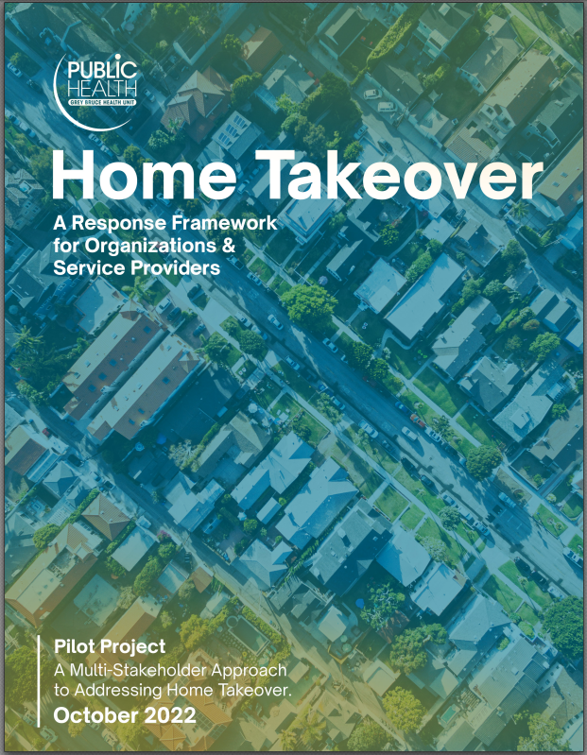
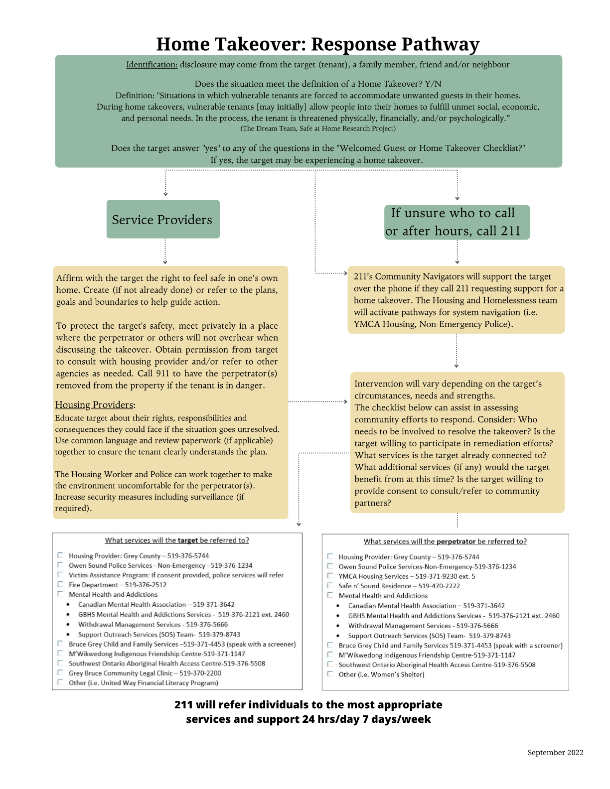
Intervention Resources
Notes:
Home Takeover Response Framework
Home Takeover Response Pathway
Suggested methods for addressing prevention, identification, intervention and after-care cited in this Guidebook and the Response Framework are a result of the literature review and consultation with Home Takeover Committee members and individuals with lived experience.
For all current resources - Home Takeover (publichealthgreybruce.on.ca)

Slide 19
Recovery
“It was helpful when [housing worker] acknowledged the problem and gave it a name”
Frequent check-ins and well-being visits
Work with client to develop recovery plan
Recovery may be centred on making the home liveable again
Consider reaching out to the perpetrator (if possible)
Ensure people removed from home takeover are housed
Go through preventative methods to avoid future takeovers
Consider seeking out other housing options if target’s safety continues to be threatened
Notes:
Aligns with p. 20 in the Guidebook
Measures to support an individual following a takeover.

Slide 20
Opportunities for Action
For Organizations:
Provide education & training for staff on Home Takeovers
Adopt and execute Home Takeover Response Framework
Encourage system changes to collect better local data
Develop home takeover policy/guideline
Update lease agreements
Collaborate with local partners and organizations
“The housing workers encouraged me to call police…and stayed with me while I called”
Notes:
*Aligns with p.17 in Guidebook

Slide 21
Opportunities for Action
For Service Providers:
Participate in education & training
Review and follow Home Takeover Response Framework
Know your role in preventing, identifying, responding to and supporting recovery
Obtain consent from tenant to support enhanced communication and information sharing with other service providers

Slide 22
Where to find more information:
All home takeover project materials can be found at:
Home Takeover (publichealthgreybruce.on.ca)

Slide 23
Acknowledgements:
Content in this presentation, and accompanying Guidebook, was adapted with permission from Crime Prevention Ottawa. Home Takeovers Guidebook (crimepreventionottawa.ca)
Thank you to all of the community partners for their ongoing support and participation in the Home Takeover pilot project. This training would not be possible without the support of the organizations below:
Grey Bruce Public Health
Grey County Housing
Grey Bruce Health Services
Owen Sound Police Services
Bruce Grey Poverty Task Force
United Way of Bruce Grey
Safe N’ Sound Grey Bruce
Canadian Mental Health Association (CMHA)
Community Connection/211 Central East Ontario
YMCA Owen Sound Grey Bruce
Southwest Ontario Aboriginal Health Access Centre
Owen Sound Municipal Non-Profit Housing Corporation
Bruce Grey Child & Family Services
M’Wikwedong Indigenous Friendship Centre

