Slide 1

Healthy Communities Initiative Update
Bruce County and Grey County Joint Council Meeting
November 24, 2016
Amber Schieck
Jason Weppler
Lynda Bumstead
Grey Bruce Health Unit

Slide 2
Outline
Healthy Communities
Factors Influencing Health?
Health in All Policies
Local Examples
  Breastfeeding Friendly Communities
  Transportation
  Above Standard Housing
  Alcohol Outlet Density Mapping
  Community Conversations
Next Steps

Slide 3
Healthy Communities
Built Environment
Social Environment
Natural Environment
Notes:
The intersection of all 3 = healthy communities
Places that support and generate good health.
Holistic view that includes “ the whole is more than the sum of its parts” and all aspects of a community are affected to each other.
An international movement.
A Healthy Communities process involves:
Equitable community engagement
Intersectoral partnerships
Political commitment
Healthy public policy
Asset-based community development
Qualities of a Healthy Community include:
Clean and safe physical environment
Peace, equity and social justice
Adequate access to food, water, shelter, income, safety, work and recreation for all
Adequate access to health care services
Opportunities for learning and skill development
Strong, mutually supportive relationships and networks
Workplaces that are supportive of individual and family well-being
Wide participation of residents in decision-making
Strong local cultural and spiritual heritage
Diverse and vital economy
Protection of the natural environment
Responsible use of resources to ensure long term sustainability
Source: http://www.ohcc-ccso.ca/en/what-makes-a-healthy-community

Slide 4





WHICH FACTOR INFLUENCES
Health?
ALL OF THE ABOVE
INCOME AND EMPLOYMENT SECURITY
FOOD SYSTEMS
ENVIRONMENT
HOUSING
TRANSPORTATION
A
B
C
D
E
F

Slide 5
WHICH FACTOR INFLUENCES
Health?
ALL OF THE ABOVE
INCOME AND EMPLOYMENT SECURITY
FOOD SYSTEMS
ENVIRONMENT
HOUSING
TRANSPORTATION
A
B
C
D
E
F
Notes:
- Is there one of these factors that would influence health the most? - discuss income / employment / education

Slide 6
Many would be surprised to learn that the greatest contribution to the health of the nation over the past 150 years was made, not by doctors or hospitals, but by local governments.
Dr. Jessie Parfitt, Public Health Physician

Slide 7
Definition of
Health in All Policies
"Health in All Policies is an approach to public policies across sectors that systematically takes into account the health implications of decisions, seeks synergies, and avoids harmful health impacts, in order to improve population health and health equity."
Notes:
Health in All Policies id an approach to improving health by incorporating health considerations into decision making across all sectors. (think of health, equity and sustainability during the process of decision making)
The term Health in All Polices emerged in the last 2 decades. There are many related terms such as healthy public policies, intersectoral action, governance for health, whole of government, (these imply addressing the social determinants of health)
Definition is from WHO
Why HiAP?
- Contributes to economic productivity. Healthier people lose fewer days of work and contribute to overall economic productivity.
- Reduces costs to the healthcare system.
- Addresses social factors known to impact population health.
- Creates opportunities for health and wellbeing especially for individuals and populations that are under-resourced.
- Increases efficiency and cost effectiveness between government ministries and departments.
- Improves collaboration across sectors.

Slide 8
Three general policy situations that favour a Health in All Policies approach
Complex Health Challenges
External Policies with High Impact on Health
Government Priority Affecting Many Sectors
Notes:
Within these situations, will need to prioritize issues. Use criteria such as: problem is of public health significance, problem is amenable to change (there is sound evidence that it can be tackled), potential solutions are politically and socially acceptable.

Slide 9
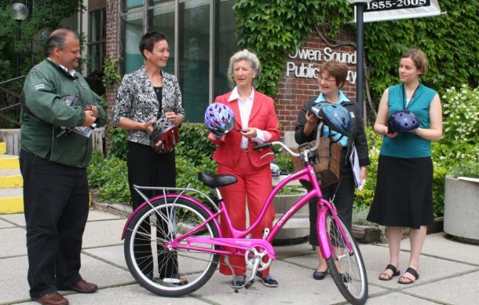
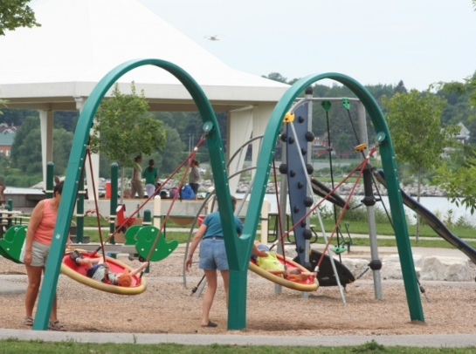

Healthy Communities in Action:
Local Examples
Notes:
Despite the relatively short history of collaboration, PH and the Counties have achieved numerous favourable outcomes over the past couple of years – I’m going to highlight 5 examples of successful collaboration.

Slide 10

Housing Initiative:
From Substandard to Above Standard
Partnership with Municipal By-Law Enforcement Officers
  Working with all 17 municipal building officials
  Conducted survey to find out:
    Type of housing complaints? Difficult situations?
    How to collaborate with other agencies such as fire, PH to resolve complaints?
    Interested in learning about housing and health?
Tenant and Landlord Focus Groups in Grey Bruce
Notes:
We all know housing plays an immense and complex role in shaping our physical, mental and social well-being. The “Above Standard Housing” project is working both locally and provincially. ASH is a partner in RentSafe, a province-wide initiative that seeks to address indoor environmental health risks (mould, dampness, pests, lack of heat) affecting low-income tenants. Locally, the program is seeking ways to improve housing conditions for marginalized populations. We know children, the elderly, people living with mental health or an addiction are disproportionately affected
Sessions have been held to engage Public health, service agencies/organizations, Municipal by-law enforcement, Tenants and Landlords

Slide 11


Breastfeeding Friendly Communities
Grey County
Bruce County
Town of South Bruce Peninsula
Municipality of Meaford
Part of the Baby Friendly Initiative (BFI), an effort to increase breastfeeding rates
Notes:
While most mothers start breastfeeding in GB (89%), only 41% are breastfeeding exclusively for the recommended first six months of life. As such,
The Health Unit has been partnering with Grey County, County of Bruce, and individual municipalities to advocate for and promote breastfeeding friendly communities. Education has been to both county councils, South Bruce Peninsula and the Municipality of Meaford. SBP passed a resolution rendering all of their municipal facilities breastfeeding friendly and signage was posted to raise awareness amongst the public. Meaford has done the same and has signage posted at ten facilities. Other Grey and Bruce County organizations are following suit. Promoting breastfeeding friendly communities is part of the our work with implementing the Baby Friendly Initiative, a global program of the World Health Organization and UNICEF that increases breastfeeding rates. Breastfeeding is a unique and cost-effective intervention that benefits children throughout their entire life span.

Slide 12
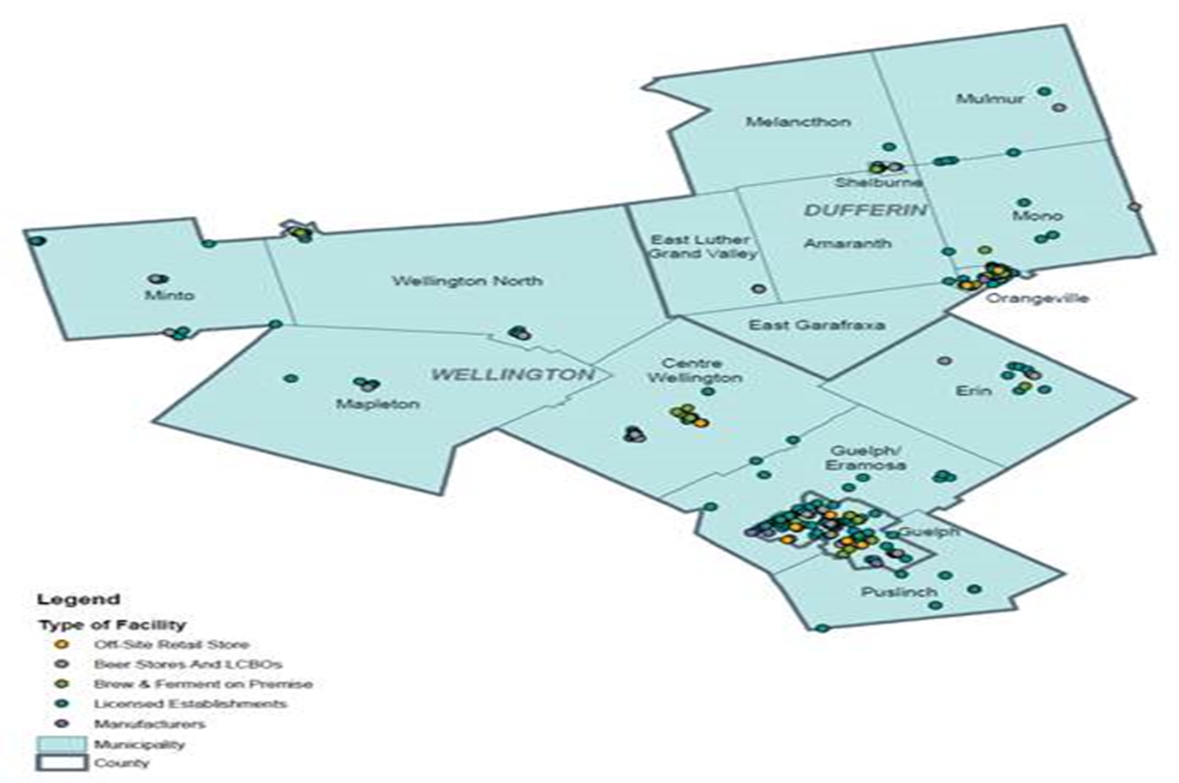
Alcohol Outlet Density Mapping
Notes:
Alcohol misuse continues to be an area of concern in Grey Bruce. We have higher rates for heavy drinking than the provincial average. As a result, we are working to support a culture of moderation in Grey Bruce. This an alcohol outlet density map developed by our partners to the south in WDG. GBHU is currently working with Justin Kraemer and Jody McEachern (Grey County’s Business Solutions Manager) to develop a similar map. This type of map will illustrates the accessibility of alcohol in our region and ultimately plays a role in determining community safety and injury prevention. Using information provided by the AGCO, we are mapping this information using ARC GIS; similar to many other layers drafted locally including the Grey Bruce Food Asset Mapping exercise. This information will be part of the Bruce Grey Data Information Sharing Collaborative.
What is the role of municipalities and the counties? This information can be used to inform planning – are there areas in our communities where outlet density should be regulated (near schools, low income neighbourhoods, etc.)? Can language be included in OP’s to support limiting outlet density.

Slide 13
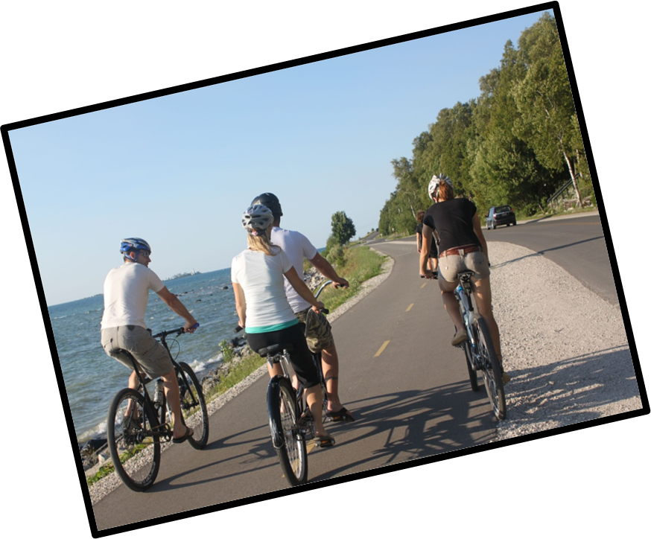
Transportation
Grey County Transportation Master Plan
Kincardine B-Line Trail
Grey Bruce Ride
Complete Streets
Notes:
Transportation is one of the biggest issues facing Bruce and Grey Counties and much work is being collaboratively done on this front. Rural transportation studies have been completed and while seniors and those with physical disabilities are found to be generally well served, youth and low income were found to be underserved in our communities. Only 10% of the potential population that would use transportation services is currently served by existing community transportation services. Led by Grey County social services, GB Ride is a community transportation pilot project to provide equitable community transportation services to seniors, persons with disabilities, etc. of Grey and Bruce counties who experience transportation barriers. Pilot Goals include:
o A single point of service access; Advanced dispatching and Consistent client service
In terms of active transportation, PH has supported GC’s TMP, coordinated with the Cty of Bruce/Muni of Kinc to investigate options for the B Line trail north of Kincardine. Not only is AT good for health but it is supports Economic Development as well In 2017, GBHU will be partnering with Saugeen Shores on projects related to Ontario by Bike, Waterfront Trail Development and Share the Road. In addition, both counties played an active role in the development and implementation of the Complete Streets Report. One of the first reports of its kind for rural communities in the province.

Slide 14






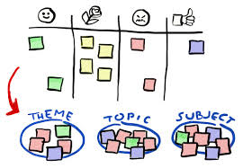

Community Conversations Project Roadmap
Stage I: Launch
Creating the Team
June 2014
Stage II: Collecting Data
Hosting Conversations
July - Dec. 2014
Stage III: Synthesis
Identifying Themes
Jan.-March 2015
Stage IV: Celebrations
Sharing What We’ve Heard
Jan-April 2015
Stage V: Action Planning
Choosing Shared Priorities
April 2015
Stage VI: Implementation
Supporting Community Action through Collective Impact
May 2015 & Beyond
Notes:
Between June 2014 AND May 2015 the GBHU, Tamarack and community partners launched a community engagement project titled Community Conversations. During this time 47 (25 in Bruce Cty and 22 in Grey Cty) conversations were conducted with community groups across GB. We asked the 407 participants questions about the meaning of community, benefits, challenges, a positive experience and a visioning exercise of their ideal community in 10 years. We shared back what we heard at 6 celebration events and discussed next steps.
So what did we hear?

Slide 15
In 10 years, my community will...
...thrive.
...be the bar that other communities strive to meet.
...be more child friendly.
...be the place to work, play and live.
...thrive and grow with happy and healthy citizens
...be vibrant and diverse.
...celebrate and protect our natural environment.
...continue to help each other through hard and good times.
...have activities for all.
Notes:
From the visioning exercise, we heard that participants wanted to see communities that…

Slide 16
Community Conversation Themes
Local Economic Development
Affordable Housing
Enhanced Local Resources
Youth Retention
Attracting Young Families
Increased Social and Leisure Opportunities
Notes:
From the data collected, we were able to synthesize the information into 6 main themes.
This information has been presented to the HCP, Grey County and shared with a variety of other partners. Findings appear to align very well with consultations undertaken by the Recolour Grey initiative.

Slide 17
Next Steps
Collaborating to:
Identify and develop local rural solutions
Integrate a health lens into policy development
Develop indicators to measure our collective impact
Notes:
Amber and Jason have highlighted some of the great steps we have taken over the years to move creating healthy communities for all forward. But we know we can do more! Population Health issues are complex and it will be by collaborating to create common agendas to support the development of local rural solutions. Within the province Bruce and Grey are seen as leaders in moving best practices forward within a rural context.
Creating communities for all requires us to address the needs of the most vulnerable within the community and to look upstream so that we can environments that are inclusive
Scope of public health services within community
Set up liaison roles with staff

Slide 18

Contact
Amber Schieck
Health Promoter
Grey Bruce Health Unit
a.schieck@publichealthgreybruce.on.ca
Jason Weppler
Health Promoter
Grey Bruce Health Unit
j.weppler@publichealthgreybruce.on.ca
Lynda Bumstead
Public Health Manager
Grey Bruce Health Unit
l.bumstead@publichealthgreybruce.on.ca

